Slide 1
Secure Cloud Native Platform

Slide 2


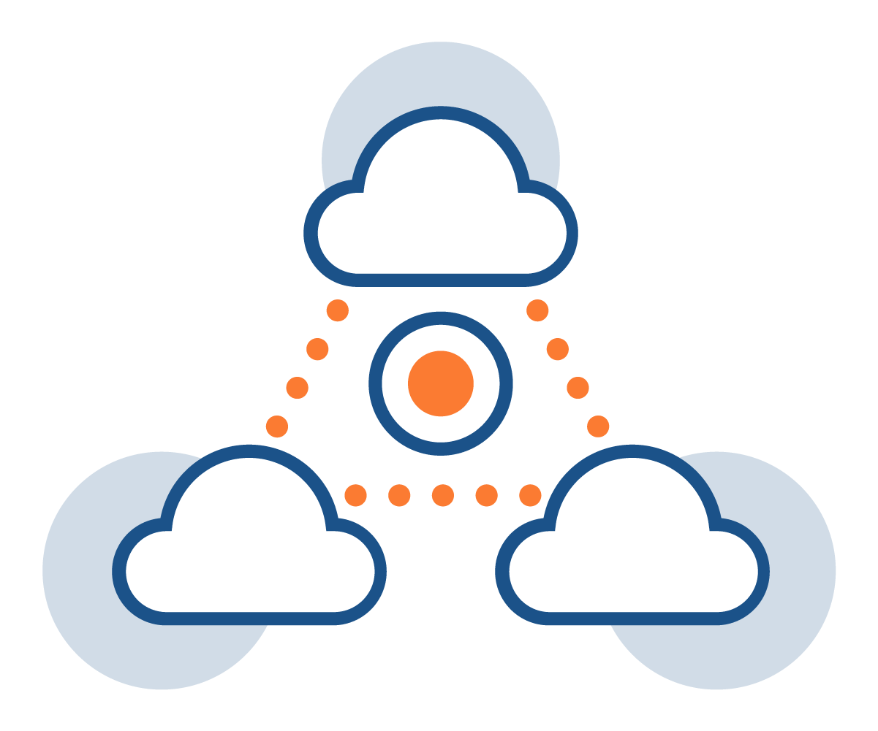


Secure Cloud Native Platform - Overview
ACL Digital offers a cutting-edge solution built on a Kubernetes-based cloud-native platform, which provides a plug-and-play architecture, allowing seamless integration of any applications into its ecosystem and enabling the operation of workloads in public and private clouds.
Seamless Integration
Wide Ecosystem Integration
Plug-and-play architecture for easy application integration.
Operate workloads in public and private clouds as desired.
Incorporates major Kubernetes tools like Cluster Management, Service Mesh, Confidential Computing, High Availability, GitOps, Zero Trust Access, Observability, Backup, and Restore.
Multi-Cloud Support
Security Enhancements
Benefits:
Simplified Operations: Manage complex cloud-native environments with ease.
DevOps Empowerment: Efficiently deploy and monitor containerized workloads.
Scalability and Flexibility: Seamlessly adapt to diverse infrastructures.
Comprehensive Security: Ensure data and infrastructure security for peace of mind.
Managed Services: Focus on innovation while ACL Digital handles critical cluster add-ons.
Run containerized workloads on any infrastructure, including Bare Metal, AWS, GCP, Azure, and Hybrid Clouds.
Role Based Access Control (RBAC), AD/LDAP Integration, Multi-Cluster, Multi-Tenancy, Multi-Cloud, Cluster Scanning, Benchmarking, Service Mesh, Admission Controllers and much more - tailored to your security posture needs.
Managed Cluster Add-ons
ACL Digital takes care of the lifecycle and configuration of critical Kubernetes services.

Slide 3



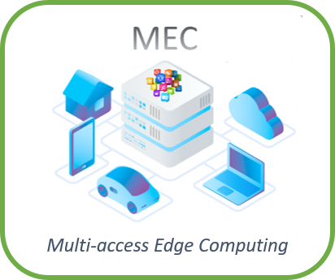
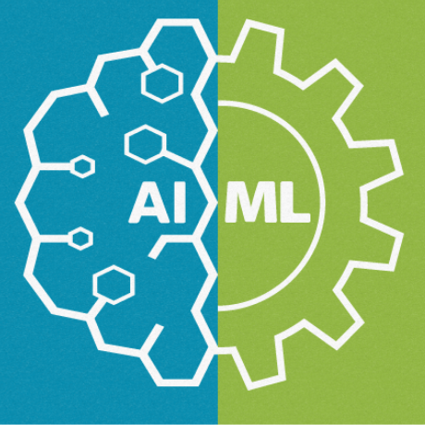
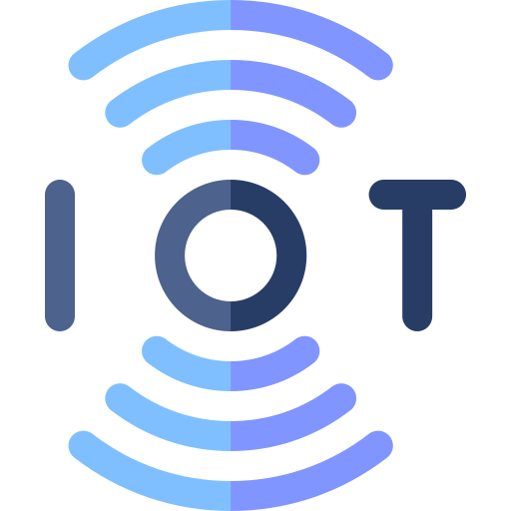
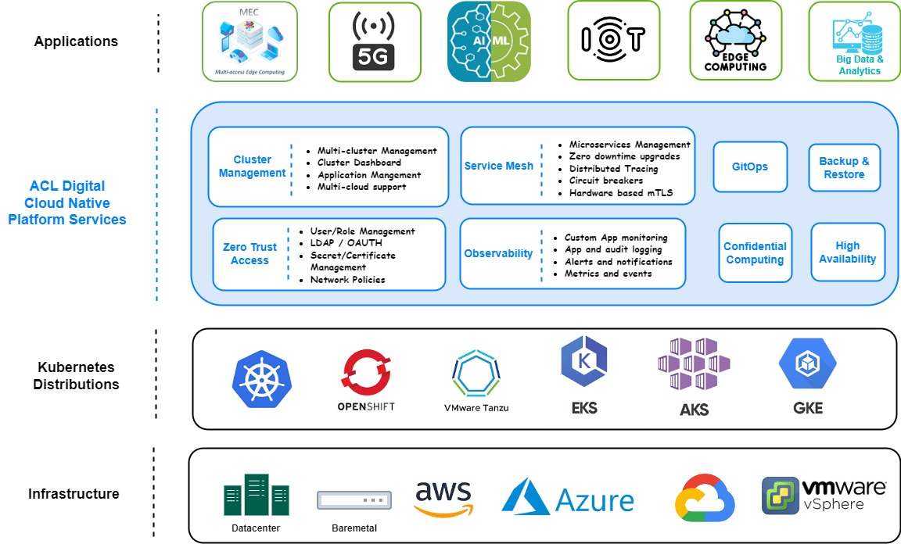
Secure Cloud Native Platform - Architecture
Application
Multi-cluster Management
Cluster Dashboard
Application Management
Multi-cloud support
Microservices Management
Zero downtime upgrades
Distributed Tracing
Circuit breakers
Hardware-based mTLS
Cluster Management
Service Mesh
GitOps
Backup & Restore
ACL Digital
Cloud Native Platform Services
Zero Trust Access
User/Role Management
LOAP/OAUTH.
Secret/Certificate Management
Network Policies
Custom App Monitoring
App and audit logging
Alerts and notifications
Metrics and events
Observability
Confidential Computing
High Availability
Kubernetes Distributions
Infrastructure

Slide 4
Secure Cloud Native Platform – Feature Highlights
Intel SGX-based key provisioning for applications
Service Mesh with External CA for secure SBI
Automated Cloud Native deployment and management of diverse workloads
Line Rate packet processing and Linear Scaling
Zero Trust Security for Edge computing
High Performance scalable pod networking
Feature Highlights
SSO and RBAC providing higher level of security
Seamless Day1 and Day2 Operations
Real Time Statistics Monitoring and Reporting
Compliance reports and altering
Custom observability factor for application-specific metrics
Secret management with SGX based secret storage

Slide 5
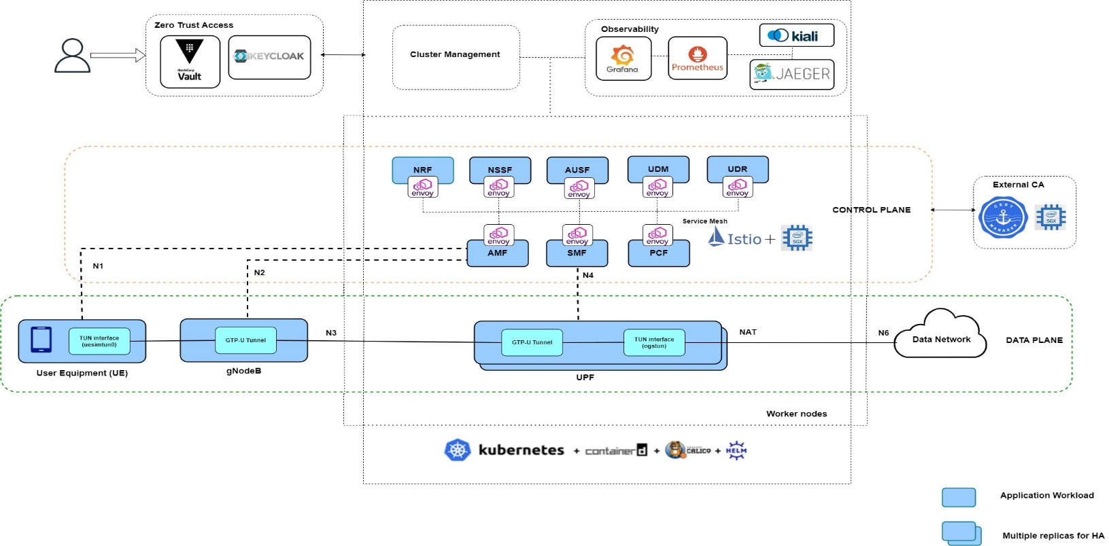
Secure Cloud Native Platform – 5G Reference Architecture

Slide 6
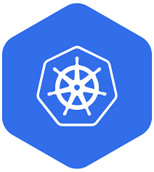


Secure Cloud Native Platform – Service Offerings
Cluster Management
Manages the entire life cycle of Kubernetes clusters deployed in Edge, Private, and Hybrid clouds.
Flexible to deploy in different locations and use cases suiting the application needs.
Automation & security via cluster deployment and version upgrades with minimal downtime.
Support for Multi-cluster management.
Confidential Computing
Intel SGX based platform attestation and key provisioning for Edge applications.
Critical 5G core, Edge and other Telecom applications that run on cloud are totally secured with SGX hardware-based security.
Gramine based containers to run the whole application inside HSM without source-code modification/recompilation.
CNF execution in SGX enclave for smallest attack surface.
Secure Service Mesh
Enhanced service mesh with HSM-based mTLS communication.
Integration with SGX-based external CA.
Interoperability Proven solution with commercial 5G stack.
Protect access to your API gateways and ingress/egress proxies.
Secured mTLS architecture across core, edge and Hybrid Clouds.

Slide 7




Secure Cloud Native Platform – Service Offerings
Zero Trust Access
Secure workload identities with HSM-based zero-trust access.
Support for SSO, Strong authentication (OAUTH2), user management, and identity federation.
Support for granular RBAC access to clusters and containerized workloads.
Real-time drift analysis to eliminate misconfigurations and vulnerabilities.
Observability with AI/ML
Customized application-specific metrics and traces for 5G CNFs.
Proactive alerting and monitoring using AI/ML to minimize application failures.
Early detection of performance bottlenecks, security threats, and abnormal resource usage.
Faster troubleshooting of issues with data from various NFs based on Network slice.
Collecting platform metrics by using collected and Telegraf agents, generating reports for high visibility of platform status and health.
High Availability
Horizontal and Vertical resource scaling based on resource demands.
Manages and monitors key data protection using backup solutions to mitigate the risk of data loss or corruption.
Traffic splitting for Canary and blue/green deployments.
Service resiliency with circuit breaking, time-out, and retries.
Automated Deployments
Ansible-playbook to automate the Kubernetes cluster provisioning.
Automatic rollout and rollback of upgrades.
Provision, scaling, update, and clean-up of clusters.
Customized profiles for service deployments across on-prem, access edge, and cloud.

Slide 8
Secure Cloud Native Platform – Use Cases
Deploy, manage, and scale containers to make sure the operations have consistency and reliability.
SGX to protect cryptographic keys and provide HSM for various workloads.
Use Cases
Visibility and control over platform and application performance.
Protect AI/ML workloads and applications by running them in the SGX enclave.
HSM-based secure mTLS communication between 5G workloads.
Customized observability for application-specific metrics and traces for diverse workloads.

Slide 9
Secure Cloud Native Platform – Use Cases
HSM-based ingress for secure communication with external services
HSM-based external CA, key server, and attestation services for secure communications over Edge.
Use Cases
Integrate traditional, modernized, and cloud-native workloads including AI/ML, IoT, and Edge.
Multi-cloud support for disaster recovery to achieve greater resilience and availability.
Application deployment across clusters in multi-cloud environments to avoid vendor lock-in.

Slide 10
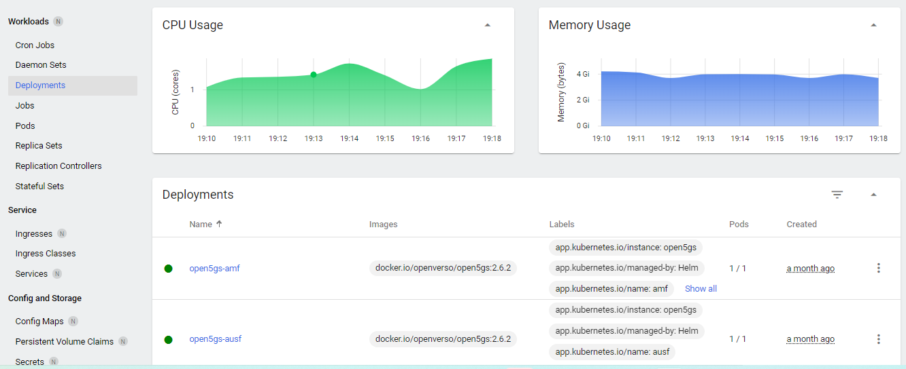
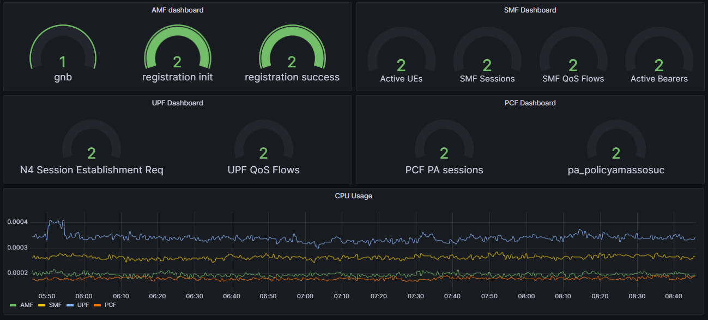
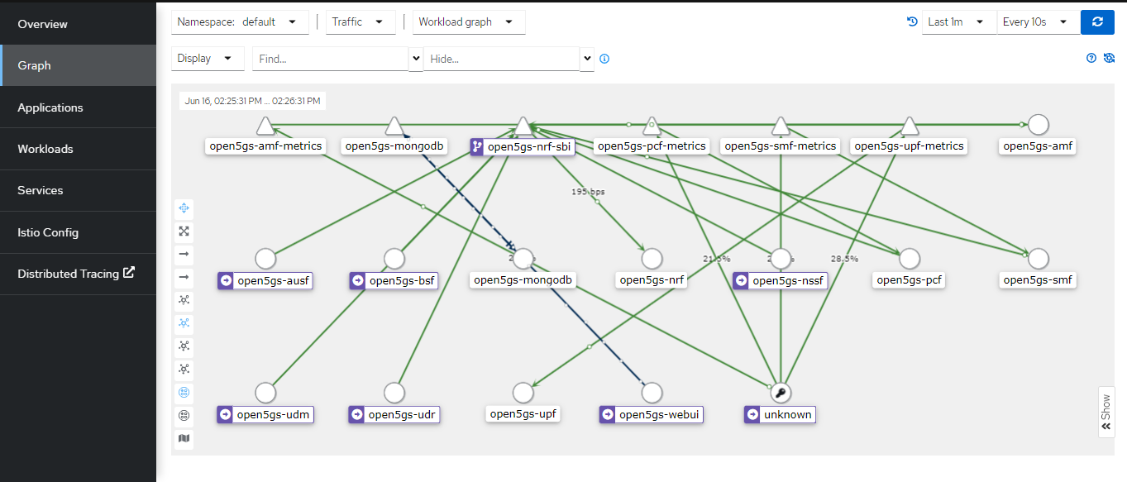
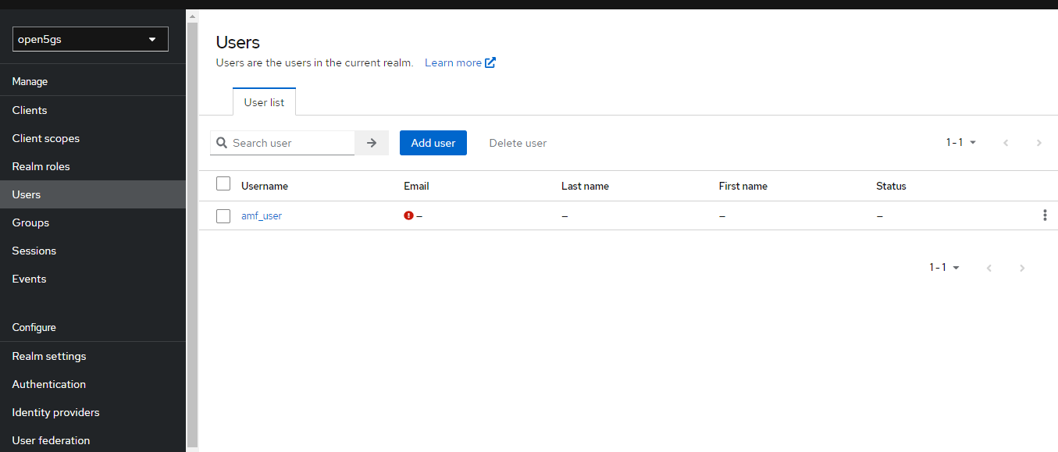
Secure Cloud Native Platform – 5G Preview

Slide 11
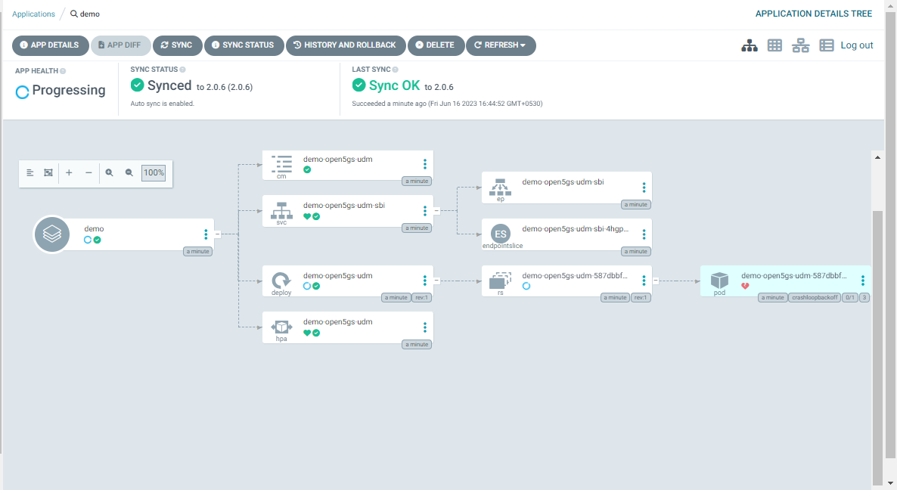
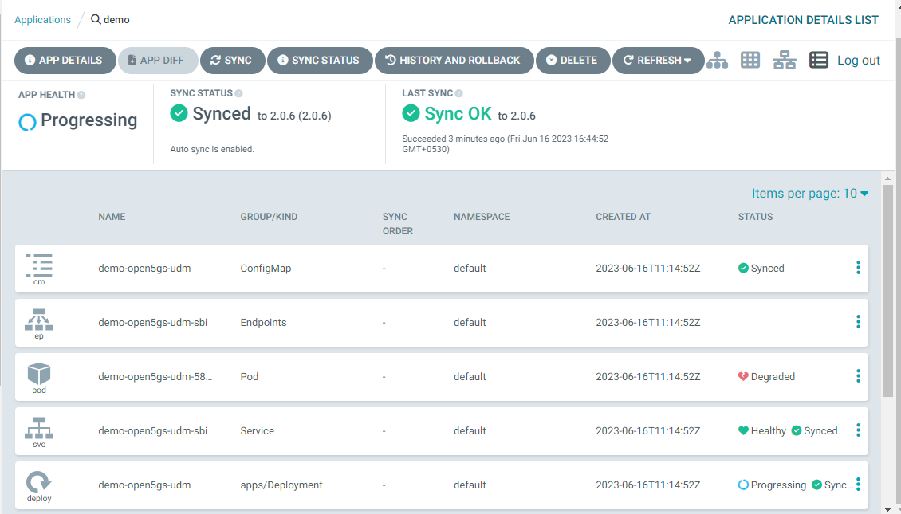
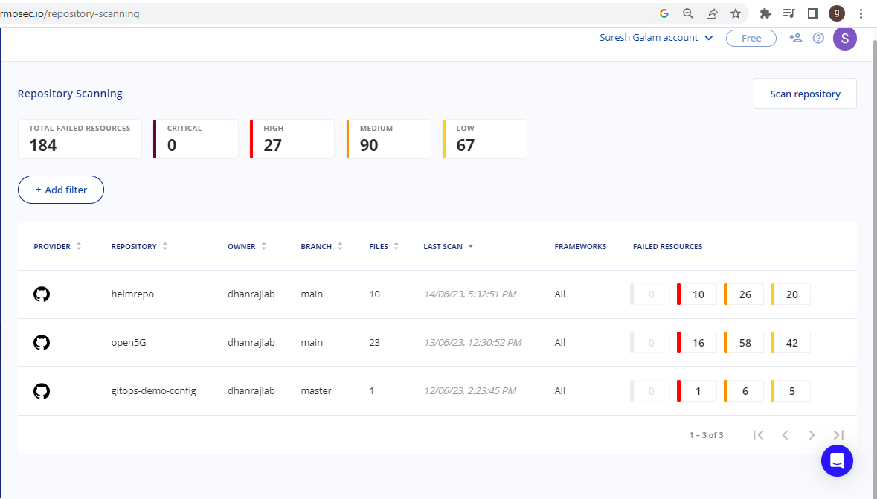
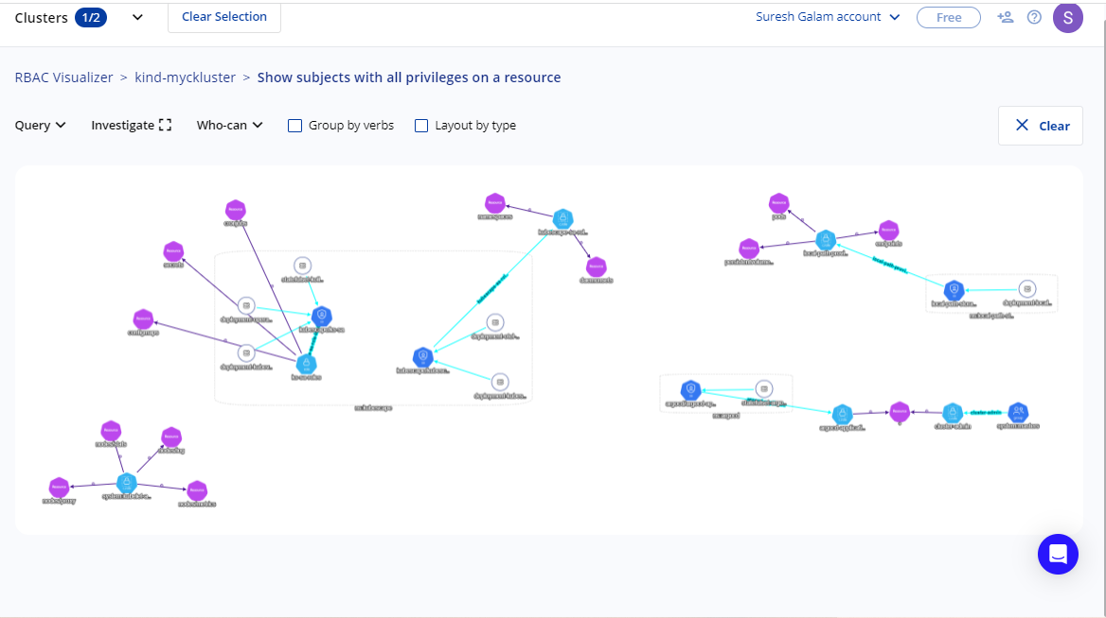
Secure Cloud Native Platform – 5G Preview

Slide 12









Thank you.
For more details, contact:
: +1 (408) 755 3000
: business@acldigital.com
: www.acldigital.com

Slide 13
Secure Cloud Native Platform - Overview
ACL Digital offers a cutting-edge Kubernetes-based cloud-native platform, designed to ensure security at every level. Seamlessly integrate applications and manage workloads across public and private clouds.
Seamless Integration
Wide Ecosystem Integration
Benefits:
Simplified Operations: Manage complex cloud-native environments with ease.
DevOps Empowerment: Efficiently deploy and monitor containerized workloads.
Scalability and Flexibility: Seamlessly adapt to diverse infrastructures.
Comprehensive Security: Ensure data and infrastructure security for peace of mind.
Managed Services: Focus on innovation while ACL Digital handles critical cluster add-ons.
Plug-and-play architecture for easy application integration.
Operate workloads in public and private clouds as desired.
Incorporates major Kubernetes tools like Cluster Management, Service Mesh, Confidential Computing, High Availability, GitOps, Zero Trust Access, Observability, Backup, and Restore.
Multi-Cloud Support
Security Enhancements
Run containerized workloads on any infrastructure, including Bare Metal, AWS, GCP, Azure, and Hybrid Clouds.
Role Based Access Control (RBAC), AD/LDAP Integration, Multi-Cluster, Multi-Tenancy, Multi-Cloud, Cluster Scanning, Benchmarking, Service Mesh, Admission Controllers
Managed Cluster Add-ons
ACL Digital takes care of the lifecycle and configuration of critical Kubernetes services.

Slide 14

Secure Cloud Native Platform – Feature Highlights
Intel SGX-based key provisioning for applications
Automated Cloud Native deployment and management of diverse workloads
Zero Trust Security for Edge computing
SSO and RBAC provide higher level of security
Real Time Statistics Monitoring and Reporting Real-Time
Custom observability factor for application-specific metrics
Service Mesh with External CA for secure SBI
Line Rate packet processing and Linear Scaling
High Performance scalable pod networking
Seamless Day1 and Day2 Operations
Compliance reports and altering
Feature Highlights
Secret management with SGX based secret storage

